Slide 1
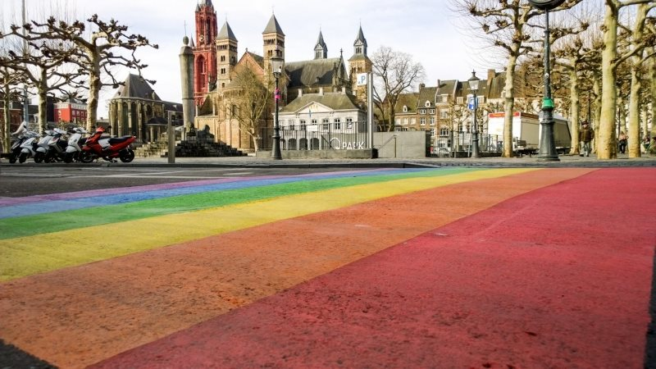
Equity, Diversity, & Inclusion in the research lifecycle
Making scholarship look like the world looks Thomas Gültzow & Hanne Zimmermann

Slide 2

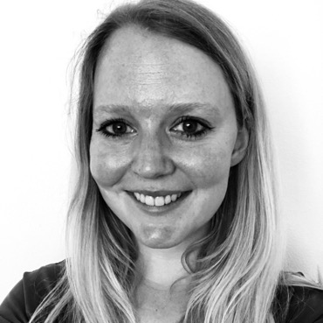


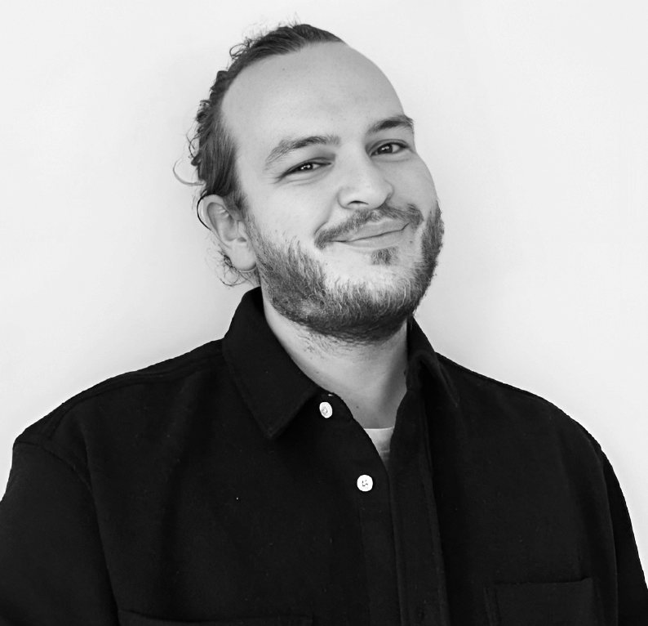

Thomas Gültzow
(he/him)
Hanne Zimmermann (she/her)

Slide 3
Disclaimer
I am a social scientist, many of my experiences are based on that

Slide 4
Disclaimer
I am privileged in many ways, but parts of my identity are also marginalized, which affects my perspectives but can also make me biased

Slide 5
Disclaimer
This short workshop highlights important considerations, but true inclusivity in research takes time and commitment

Slide 6
And you? Tell us about yourself

Slide 7
Making Scholarship Look Like The World Looks What does this mean to you?

Slide 8
Diversity in scholarship
What does this mean to you?

Slide 9
Inclusivity in scholarship
What does this mean to you?

Slide 10
Outline
Making scholarship Look Like the World Looks Why is it important?
Strategies How to overcome it?

Slide 11
Making Scholarship Look Like The World Looks
Why is it important?

Slide 12

Do you agree?
(Photo/Sarah E. Freeman/Grady College, freemans@uga.edu in New York City, Georgia, on Saturday, May 21, 2016), CC BY-SA 4.0, via Wikimedia Commons
“I really hate the word ‘diversity’. It suggests something … other. As if it is something … special. Or rare. Diversity! As if there is something unusual about telling stories involving women and people of color and LGBTQ characters on TV. I have a different word: normalizing. I’m normalizing TV. I am making TV look like the world looks. Women, people of color, LGBTQ people equal way more than 50% of the population. Which means it ain’t out of the ordinary.”
Shonda Rhimes (Rhimes, 2015)

Slide 13
Making Research Look Like the World Looks
Research is
the creation of new knowledge and/or the use of existing knowledge in a new and creative way (Australian Research Council, 2015)
meant to learn something new about “something” than can be applied to “a large group of people”

Slide 14
Generalizability
Ideally, participants in research studies should closely mimic the demographic diversity of the general population or the prevalence of a phenomenon or disease. Research results are considered generalizable when the findings can be applied to “most contexts”, “most people”, “most of the time”.

Slide 15
Most contexts? Most people? Most of the time?
“Compared with white [people] […], [B]lack [people] […] and Hispanic [people] […] were underrepresented in these trials relative to their proportion among the US cancer population.”
(Loree et al., 2019)

Slide 16
HIV Cure Research Demographic (Boone & Jefferys, 2022)

Slide 17
Other examples
Psychological research often relies on Western, educated, industrialized, rich, and democratic (WEIRD) (Henrich et al., 2010) & heteronormative (Thorne et al., 2019) samples
Psychological research also often fails to account for BIPOC (Black, Indigenous, and other People of Colour) populations (Buchanan et al., 2021)

Slide 18
Consequences of lack of diversity in research
Lack of generalizability of study findings can be dangerous
Unethical and creates inequity
Not inclusive, marginalized groups can be disregarded

Slide 19
Example from Medicine (Vogel et al., 2021)
Heart disease in women is the number 1 leading cause of death among women
Why? Women are understudied, under-recognized, underdiagnosed, undertreated, and under-represented in clinical trials

Slide 20


Examples from Health Psychology (Schüz et al., 2017)
Intention
Behavior
Can be much weaker among people with a lower level of education

Slide 21
Research should be
Diverse
Inclusive

Slide 22
Making Research Look Like the World Looks

Slide 23
Making Research Look Like The World Looks
Strategies to improve it

Slide 24
Strategies: how to solve it?
Pre-registrations
Engaging communities: Participatory research approaches

Slide 25
Pre-registrations
Goal: Transparency
Make researchers think about diversity and inclusivity in research and make decision about it before (pre-) they conduct any of it
Many existing pre-registration forms for different types of research

Slide 26
In what steps of the research cycle is making decisions about diversity and inclusivity important?

Slide 27
Interactive part
Lesbian, gay, bisexual, transgender, intersex, or queer (LGBTIQ+) individuals with refugee status face unique challenges due to their dual identity.
These challenges include trauma, feelings of isolation in new environments, and barriers to accessing appropriate support services.
Research Question
What are the mental health experiences and challenges of LGBTIQ+ individuals with refugee status?
Case

Slide 28
Interactive part
Explain the composition of the research team in terms of different characteristics (such as geography, sexual orientation, gender, race, ethnicity) and how those relate to the research itself.
This information should only be shared if it is safe to do so.
What specific characteristics are important for describing the composition of the research team conducting this study?
Research team composition

Slide 29
Interactive part
Lesbian, gay, bisexual, transgender, intersex, or queer (LGBTIQ+) individuals with refugee status face unique challenges due to their dual identity.
These challenges include trauma, feelings of isolation in new environments, and barriers to accessing appropriate support services.
What specific characteristics are important for describing the composition of the research team conducting this study?
Research team composition

Slide 30
Interactive part
Explain if and how your data allows for disaggregation between different social groups and make this explicit in all hypotheses.
Which data collection method would you recommend for this case, and what would be the reason for that?
Hypotheses

Slide 31
Interactive part
Explain how you will take into account the diversity of your target group in terms of data collection methods.
For example, you could describe the different data collection methods you use to reach as diverse a target audience as possible.
Which data collection method would you recommend for this case, and what would be the reason for that?
Data collection method

Slide 32
Interactive part
Lesbian, gay, bisexual, transgender, intersex, or queer (LGBTIQ+) individuals with refugee status face unique challenges due to their dual identity.
These challenges include trauma, feelings of isolation in new environments, and barriers to accessing appropriate support services.
Which data collection method would you recommend for this case, and what would be the reason for that?
Data collection method

Slide 33
Interactive part
Describe the (target) population of your study and why this specific population was chosen, taking into account inclusivity and diversity.
Population

Slide 34
Interactive part
Explain how you will take the diversity of your target group into account in relation to recruitment, retention, data analysis, and interpretation.
How would you recruit people to participate in the described study, taking into account their individual characteristics?
Sample composition

Slide 35
Interactive part
Lesbian, gay, bisexual, transgender, intersex, or queer (LGBTIQ+) individuals with refugee status face unique challenges due to their dual identity.
These challenges include trauma, feelings of isolation in new environments, and barriers to accessing appropriate support services.
How would you recruit people to participate in the described study, taking into account their individual characteristics?
Sample composition

Slide 36
Interactive part
Explain how you decided which personal characteristics are measured in the study and how those are relevant for your study taking inclusivity and diversity into account.
What personal characteristic do you consider important to measure in this study, and why?
Measured variables

Slide 37
Interactive part
Lesbian, gay, bisexual, transgender, intersex, or queer (LGBTIQ+) individuals with refugee status face unique challenges due to their dual identity.
These challenges include trauma, feelings of isolation in new environments, and barriers to accessing appropriate support services.
What personal characteristic do you consider important to measure in this study, and why?
Measured variables

Slide 38
Interactive part
Explain whether and how (if applicable) your data will be disaggregated for all relevant groups separately also keeping intersectionality in mind and how potential undersized groups (from a statistical point of view) will be handled in the data analysis phase.
If this is not possible, explain why.
Disaggregation

Slide 39
Interactive part
If a dataset associated with the study is publicly shared, and in it variables from multiple groups have been recoded based on personal characteristics, explain if and how (if applicable) you ensure that other researchers can work with the more detailed data while respecting the privacy of the participants.
If this is not possible, explain why.
Recoded data information

Slide 40
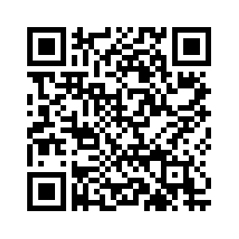
Interested? Read more here.
https://shorturl.at/UUV07

Slide 41
Making Research Look Like The World Looks
Strategies to improve it

Slide 42
Community-based participatory approach
Multiple terms used interchangeably:
What they have in common:
Collaborative approach between researchers, organizations and communities
Recognition of the strengths and resources of a community
Relevance of community-defined problems
Iterative process to develop and maintain community partnerships
Dissemination of knowledge gained from the CBPR project to and by all involved partners
Action research
Action inquiry
Community-based research
Action Science
Participatory action research
Participatory research
Cooperative inquiry

Slide 43
Necessity of CPBR
Lacking expertise of community-defined problems
Top-down approaches often don’t work as they don’t tackle community-defined problems
Notes:
In CBPR, the knowledge and expertise of community members matters as much as formally trained researchers’ expertise. In addressing health disparities, for instance, community members’ knowledge almost always provides a critical complement to an epidemiologist’s expertise. Though the epidemiologist understands the biological basis of disease, the researcher generally does not understand precisely the underlying socioeconomic realities that foster disease in a certain community, or that might make solutions impossible or difficult to implement. The community member, who daily encounters these underlying problems, provides essential data, often the pieces of the research puzzle that are missing.

Slide 44
Why can it help?
Overcome barriers to participating in research:
Language barriers
Mistrust
Inaccessibility
Increases empowerment

Slide 45
3 key CBPR components
Community Defined: the problem under investigation is defined by the community itself, or in collaboration with the formally trained researchers
Equitable Collaboration: power and decision-making are shared in all phases of the research and intervention processes
Action Outcome: the project must include a component that enables direct action on the problem set under investigation

Slide 46
The research cycle
CBPR
Identifying priority public health issues & research questions
Designing the research and policy questions
Feedback & interpretation of the findings
Disseminating and translating research findings
Assessing community strengths & dynamics
CBPR begins with a research topic of importance to the community…
… and has the aim of combining knowledge with action to achieve social change.
Adjusted from: (The Detroit Community-Academic Urban Research Center, n.d.)

Slide 47
The research cycle
Identify existing community knowledge and skills
Identify community individuals or organizations to partner with
Identify where assistance in further developing community members', institutions' and organizations' skills, resources, and competencies is needed
Assessing community strengths & dynamics

Slide 48
The research cycle
Community defined problems
What is the problem at hand?
What are the underlying factors, why is it a problem?
What is needed and what needs to change?
Who is needed for change?
What is NOT needed?
Etc…
Data collection
Surveys, interviews, focus groups, etc…
Designing the research and policy questions

Slide 49
The research cycle
Data analysis
Endpoints are discussed together
Data analysis varies on skills: choice of data analysis method, conducting analysis
Data interpretation (!) – validation of research findings
Relying on community strengths & dynamics → Cultural humility
Feedback & interpretation of the findings

Slide 50
The research cycle
Data dissemination
Communities guide what is most important to disseminate
Discuss who needs to disseminate what to whom?
Academic
Policy makers
Communities
Discuss how do we disseminate to whom?
Research articles, policy briefs, video’s, factsheets, etc…
Translation of findings into action
Active role for community for maintenance
Disseminating & translating research findings

Slide 51
An example
CBPR
Identifying priority public health issues & research questions
Designing the research and policy questions
Feed back & interpretation of the findings
Disseminating and translating research findings
Assessing community strengths & dynamics
Example of a CBPR project – working with Trans* migrant communities in the Netherlands
Adjusted from: (The Detroit Community-Academic Urban Research Center, n.d.)

Slide 52
An example
Collaboration between Public Health Service Amsterdam (researchers) and Trans United Europe (community organization)
Started Transclinic Amsterdam in response to the fact that Trans* individuals were often not seen in care
Assessing community strengths & dynamics

Slide 53




Community dynamics led to starting the Co-led Amsterdam Trans Clinic
Amsterdam Trans Clinic
Co-led: Trans doctors and volunteers from the trans community
For people from the trans and gender diverse community who experience barriers to regular care (not seen at GGD nor gender centres (e.g. VU)
Integrated (care) Services
Hormone Support; Sexual Health Services; Psychosocial Suppot; Legal advice

Slide 54
Slides: Camiel Welling Fast Track Cities conference 2022
How CBPR can help:

Slide 55
Slides: Camiel Welling Fast Track Cities conference 2022
How CBPR can help:

Slide 56
RQ: In-depth explorations barriers to care among trans migrants
! although RQ not initiated directly by community, it was a response to community dynamics that led to starting the co-led Trans Clinic & this specific RQ to be able to advocate for change
Designing the research and policy questions

Slide 57
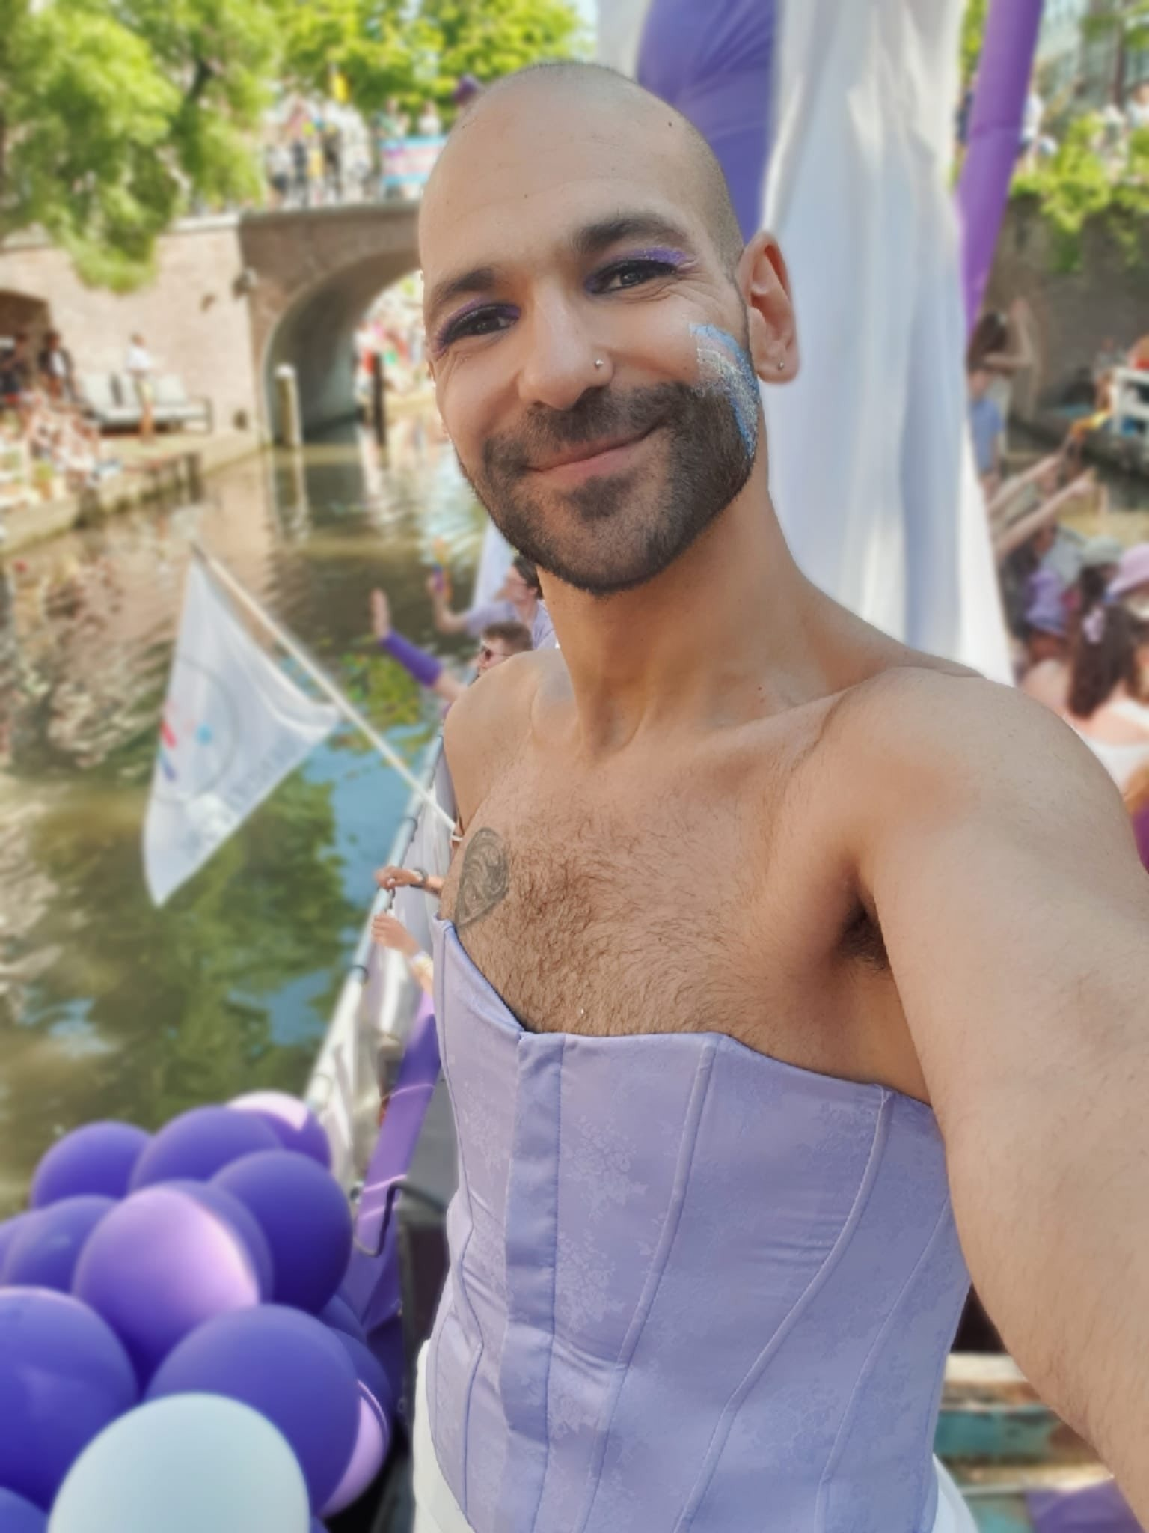
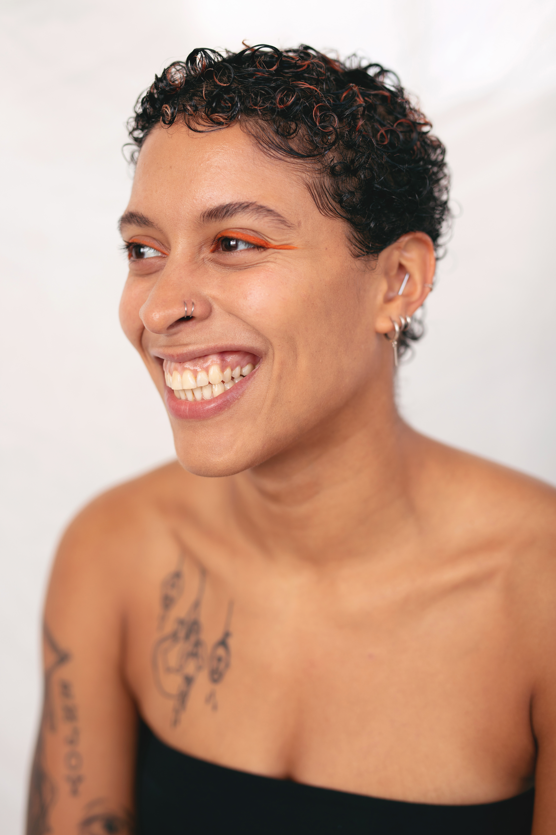
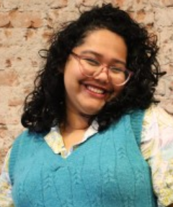
Team: Involvement of community members
Ali Jawad They/Them
Member Trans United Europe, Music therapist
Role: data collection, interpretation, dissemination
Sabrina Sanchez She/Her
Director European Sex Work Alliance
Role: data collection, interpretation, dissemination
Designing the research and policy questions
Ella Smith Jr They/Them
Member Colored Qollective, teacher intersectionality, tattoo artist
Role: data collection, interpretation, community dissemination
Raagini Bora She/Her
Social science researcher Fite Club
Role: data collection, interpretation, community dissemination

Slide 58
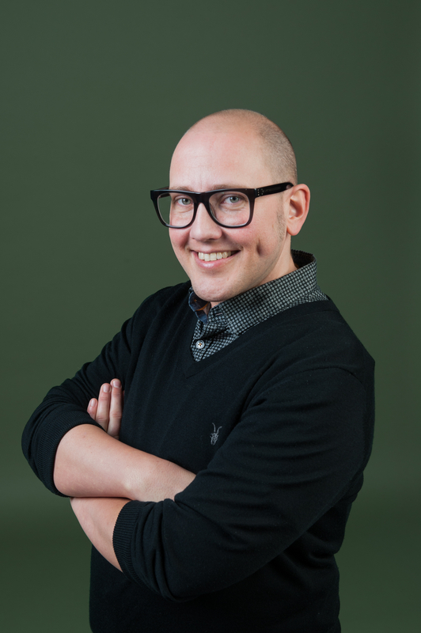

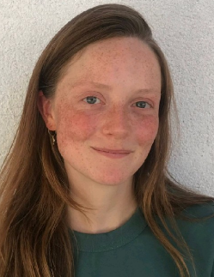
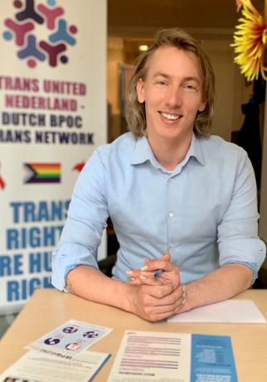
Team: Researchers GGD Amsterdam
Alex von Vaupel-Klein He/Him
Doctor Trans Clinic
Role: Analysis, interpretation, dissemination
Hanne Zimmermann She/Her
Researcher GGD Amsterdam
Role: Analysis, interpretation, dissemination
Designing the research and policy questions
Eline Wijstma She/Her
PhD candidate GGD Amsterdam
Role: Analysis, interpretation, dissemination
Camiel Welling He/Him/They/Them/ She/Her
Doctor Trans Clinic
Role: Recruitment, interpretation, dissemination

Slide 59
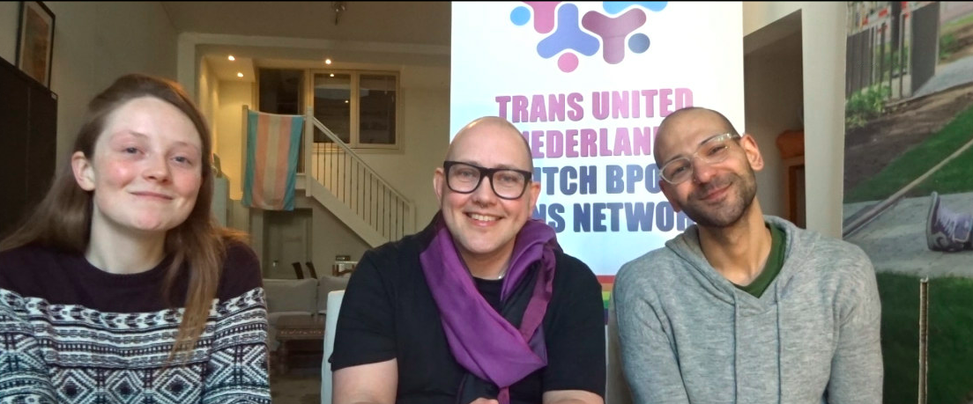
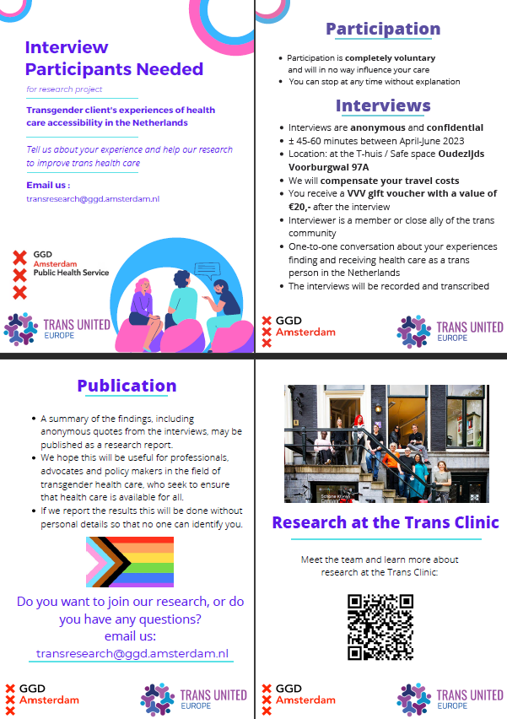
Low-threshold recruitment & community interviewers
Recruitment video involving community researchers
Recruitment flyer instead of difficult information letter
Interviews done by and among people closely connected to the trans community
2 non-binary persons
1 trans woman
1 partner of a trans person
Designing the research and policy questions

Slide 60
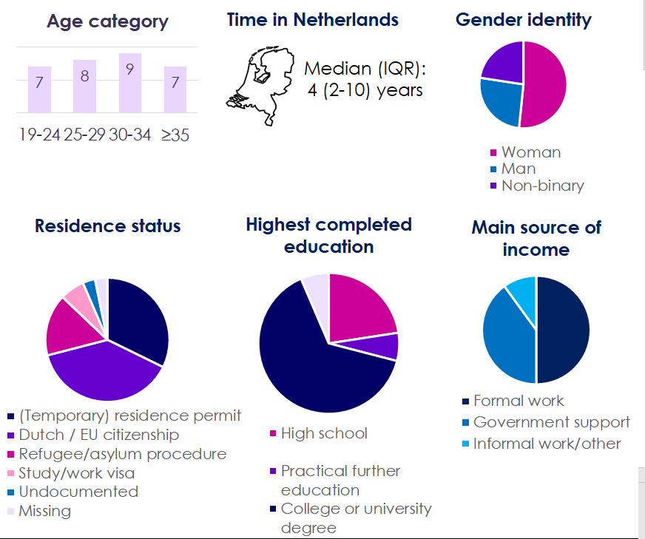
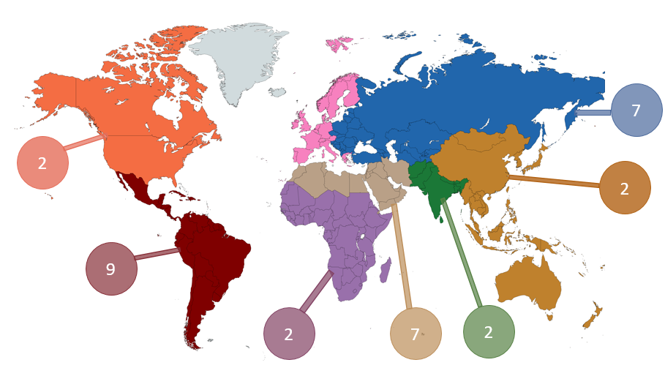
Result: Trust in community researchers led to diverse sample

Slide 61
Ongoing feedback on interpretation of findings
Several meetings to discuss interpretation of findings with community members
Weekly to reflect on interpretations of interviews
Several team meetings to discuss overall interpretation and presentation of findings to check reflections and provide nuance by community members
Feedback & interpretation of the findings

Slide 62
Dissemination to community, policy and scientific audience: “How to give back” and achieve social change
Disseminating and translating research findings
Discussion of most important findings to disseminate:
Integrated care can provide opportunity to entry care in case of competing concerns → Basic needs (e.g. housing) above finding care
Lack of knowledge among primary health care providers (e.g. GPs, AZC doctors) for gender-related needs
Interactions with health care providers breaches trust in provider & discontinuation of care
Hard to navigate Dutch health care system for newcomers + No info available in multiple languages - “Impossible” without social network

Slide 63
Dissemination to community, policy and scientific audience: “How to give back” and achieve social change
Disseminating and translating research findings
Community audience:
Videos with interim and final finding for community
Presentations at community organizations
English report & infographics in multiple languages with additional information (e.g. right to care, health system, tips/tricks)
Policy audience:
Lobby with ministry of health to substantiate role of Trans Clinic Integrated Care in Dutch healthcare landscape
Advice to new transgender care guidelines (e.g. what is the role of public health and what can GPs do)

Slide 64
Dissemination to community, policy and scientific audience: “How to give back” and achieve social change
Scientific audience:
Community interviewers are co-author on abstracts and papers
Disseminating and translating research findings

Slide 65


CBPR
Identifying priority public health issues & research questions
Designing the research and policy questions
Feed back & interpretation of the findings
Disseminating and translating research findings
Assessing community strengths & dynamics
Strengths?

Slide 66
CBPR
Identifying priority public health issues & research questions
Designing the research and policy questions
Feed back & interpretation of the findings
Disseminating and translating research findings
Assessing community strengths & dynamics
Response to strong academic / NGO collaboration & existing knowledge
Low-key recruitment
Community researchers
Empowerment of community interviewers: - research skills - contract at recognized organization - recommendation letters
Action points came from community & gives back to community
Continuous feedback

Slide 67
CBPR
Identifying priority public health issues & research questions
Designing the research and policy questions
Feed back & interpretation of the findings
Disseminating and translating research findings
Assessing community strengths & dynamics
Challenges?

Slide 68

CBPR
Identifying priority public health issues & research questions
Designing the research and policy questions
Feed back & interpretation of the findings
Disseminating and translating research findings
Assessing community strengths & dynamics
RQ not directly from community
Interview guide development mainly done by researchers
No direct role in recruitment
No role in dissemination to policy / scientific conferences, only to community
Coding/analysis done mainly by researchers

Slide 69
Q&A

Slide 70
References
Australian Research Council. (2015). Australian Research Council, State of Australian University Research 2015–16—. https://www.arc.gov.au/sites/default/files/minisite/static/4551/ERA2015/intro-3_define-research.html
Boone, C. A., & Jefferys, R. (2022). Community Representation in HIV Research: From Study Volunteers to Investigators. Treatment Action Group. https://www.treatmentactiongroup.org/resources/tagline/tagline-november-2022/community-representation-in-hiv-research-from-study-volunteers-to-investigators/
Brandenberger, J., Tylleskär, T., Sontag, K., Peterhans, B., & Ritz, N. (2019). A systematic literature review of reported challenges in health care delivery to migrants and refugees in high-income countries—The 3C model. BMC Public Health, 19(1), 755. https://doi.org/10.1186/s12889-019-7049-x
Henrich, J., Heine, S. J., & Norenzayan, A. (2010). Most people are not WEIRD. Nature, 466(7302), 29–29. https://doi.org/10.1038/466029a
Loree, J. M., Anand, S., Dasari, A., Unger, J. M., Gothwal, A., Ellis, L. M., Varadhachary, G., Kopetz, S., Overman, M. J., & Raghav, K. (2019). Disparity of Race Reporting and Representation in Clinical Trials Leading to Cancer Drug Approvals From 2008 to 2018. JAMA Oncology, 5(10), e191870–e191870. https://doi.org/10.1001/jamaoncol.2019.1870
Rhimes, S. (2015, March 16). “You Are Not Alone.” Medium. https://medium.com/@shondarhimes/you-are-not-alone-69c1a10515ab
Schüz, B., Li, A. S.-W., Hardinge, A., McEachan, R. R. C., & Conner, M. (2017). Socioeconomic status as a moderator between social cognitions and physical activity: Systematic review and meta-analysis based on the Theory of Planned Behavior. Psychology of Sport and Exercise, 30, 186–195. https://doi.org/10.1016/j.psychsport.2017.03.004
The Detroit Community-Academic Urban Research Center. (n.d.). Home | Detroit Urban Research Center. Retrieved June 27, 2023, from https://www.detroiturc.org/
Thorne, S. R., Hegarty, P., & Hepper, E. G. (2019). Equality in theory: From a heteronormative to an inclusive psychology of romantic love. Theory & Psychology, 29(2), 240–257. https://doi.org/10.1177/0959354319826725
Vogel, B., Acevedo, M., Appelman, Y., Merz, C. N. B., Chieffo, A., Figtree, G. A., Guerrero, M., Kunadian, V., Lam, C. S. P., Maas, A. H. E. M., Mihailidou, A. S., Olszanecka, A., Poole, J. E., Saldarriaga, C., Saw, J., Zühlke, L., & Mehran, R. (2021). The Lancet women and cardiovascular disease Commission: Reducing the global burden by 2030. The Lancet, 397(10292), 2385–2438. https://doi.org/10.1016/S0140-6736(21)00684-X
Wallerstein, N., & Duran, B. (2010). Community-Based Participatory Research Contributions to Intervention Research: The Intersection of Science and Practice to Improve Health Equity. American Journal of Public Health, 100(Suppl 1), S40–S46. https://doi.org/10.2105/AJPH.2009.184036

Slide 71
THANK YOU 🎉
Thomas Gültzow
(he/him)
Hanne Zimmermann (she/her)

